Slide 1
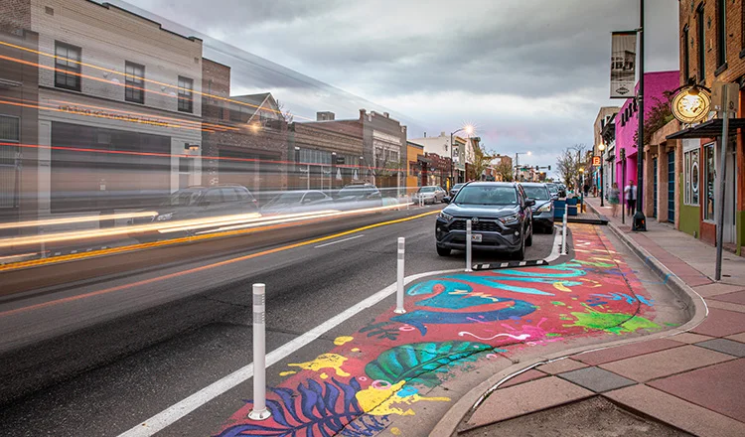
Integrating AI, Deep Learning, and Spatial Analytics to Investigate Environmental Correlates of Child Neglect
A Novel Integration of Social, Perceptual and Built Environmental Data to Predict Child Neglect Risk in Los Angeles, California
Gia Elise Barboza-Salerno, MA, MS, JD, PhD
Colleges of Social Work and Public Health
The Ohio State University
Creator: Investigating Spatial Structures in Urban Environments (ISSUES) lab
barboza-salerno.1@osu.edu

Slide 2
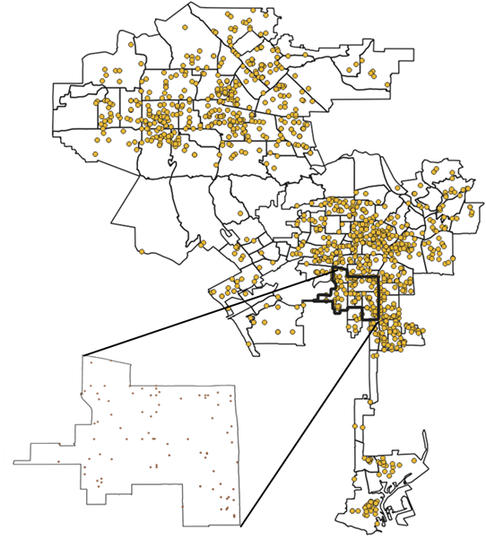
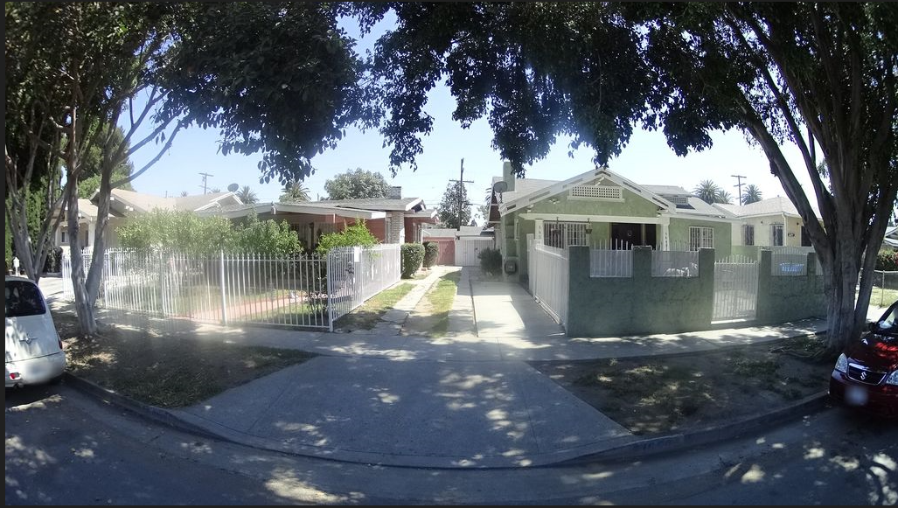
From Streets to Statutes: How Urban Environments Shape Neglect Risk
Child neglect is a public health and civil rights crisis
Legal Context
California WIC § 300(b)(1): Neglect is the failure of a parent or guardian to provide adequate food, clothing, shelter, or supervision, placing a child at risk of serious harm.
Why ‘Place’ Matters
Neglect is not solely the result of individual or family circumstances.
Risk is shaped by the neighborhoods where families live.
Environmental conditions — housing quality, access to services, exposure to hazards — often align with the legal definitions of neglect.
The AI Advantage
Connects objective measures (e.g., infrastructure, green space) with subjective impressions (e.g., safety, upkeep).
Produces a fuller picture of environments that may increase neglect risk.
Extends and strengthens research on place-based prevention and intervention.

Slide 3
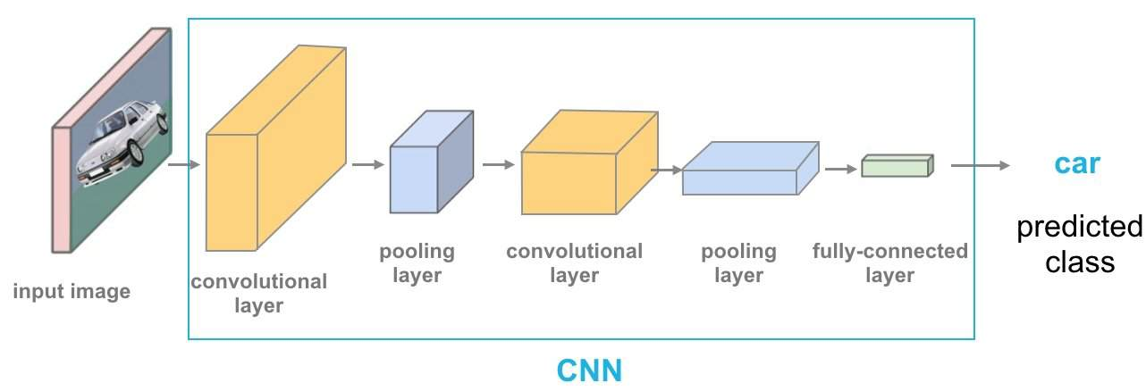
From Pixels to Neighborhood Patterns: How AI translates images into indicators
AI uses computer vision models — powered by deep learning–based semantic segmentation — to teach computers how to ‘look’ at images. The system scans every pixel in a street-level photo, interprets what it sees, and labels each feature, pixel-by-pixel.“
Using AI-driven computer vision on street-level images, you can:
Measure the built environment (e.g., green space, building structures, and open areas)
Evaluate neighborhood infrastructure (e.g., sidewalks, roads, lighting, and public spaces)
Gauge local perceptions: how do people evaluate the environment (e.g., do they feel safe)?

Slide 4
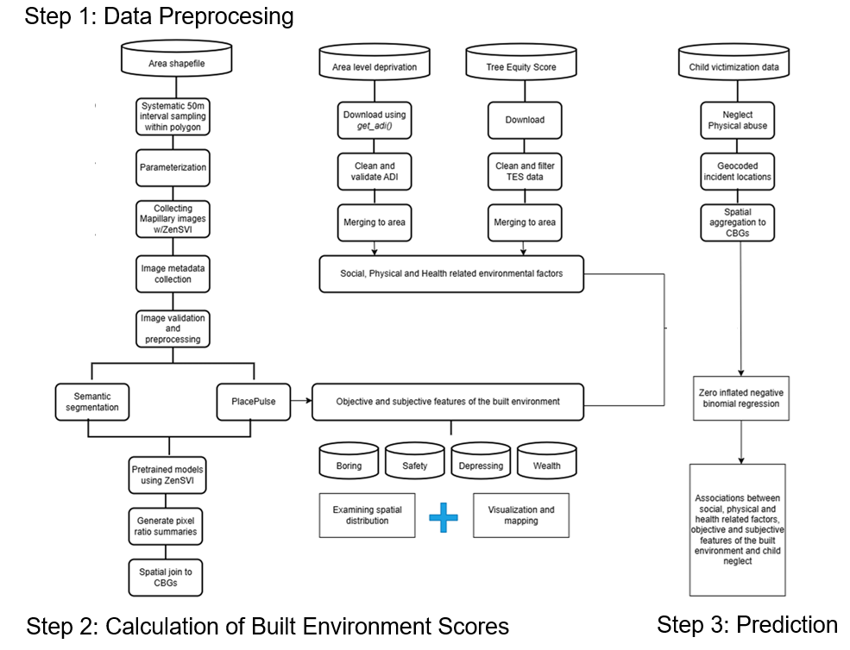
Connecting the Built Environment and Perceptions of Place to Neglect Risk

Slide 5
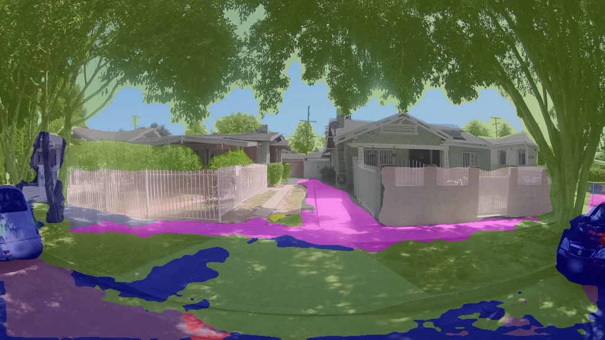
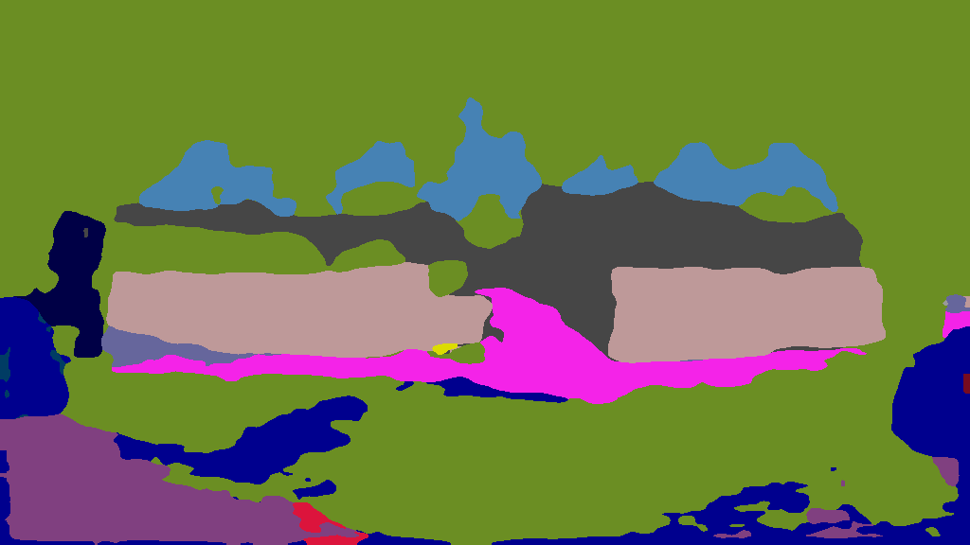
AI-driven Semantic Segmentation
Original Image
Street-level image showing
Homes
Vegetation
Vehicles
Sidewalks
Roads
Segmentation Overlay AI highlights each feature:
Light Brown/Grey: Building façades
Green: Vegetation
Blue: Vehicles
Pink/Purple: Sidewalks
Dark Blue: Roads
Segmentation Mask
AI segmentation detects the most common categories in each image
59.1% vegetation
9.64% fences
7.76% buildings
4.94% roads
4.31% sidewalks

Slide 6
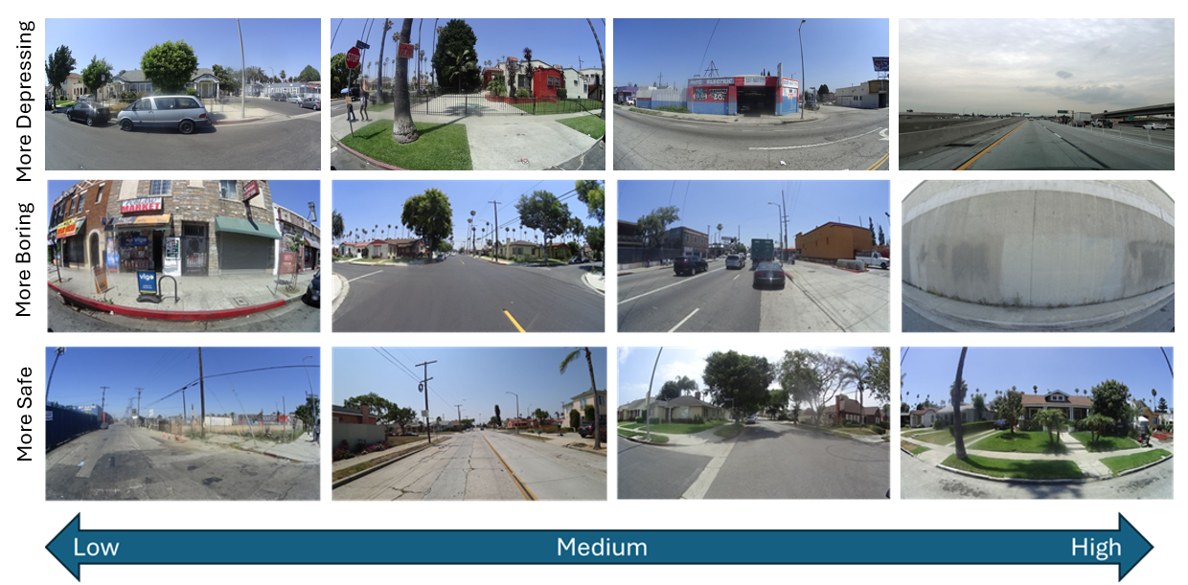
Add Perception Scores
Classified images using deep learning models trained to recognize subjective impressions
0
10

Slide 7
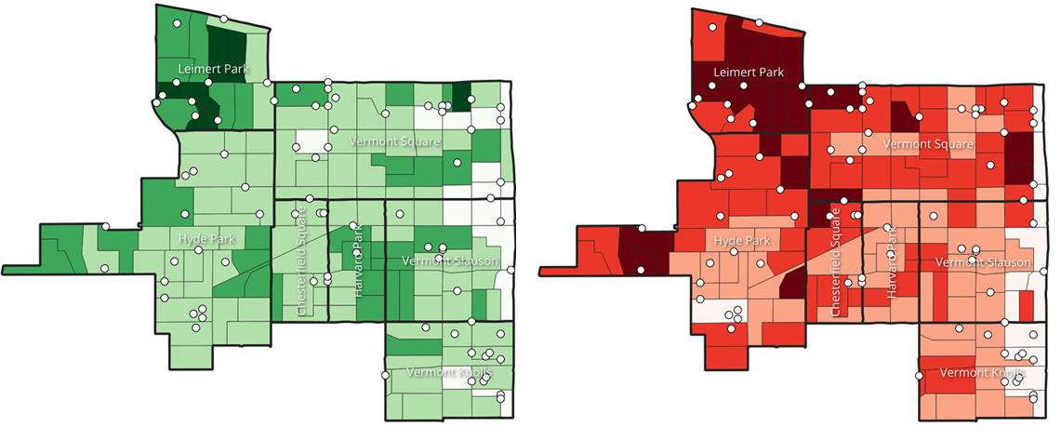
The Spatial Distribution of the Built and Perceived Environment
Neighborhood Vegetation
(Objective Score Summary)
Neighborhood Safety
(Perception Score Summary)

Slide 8
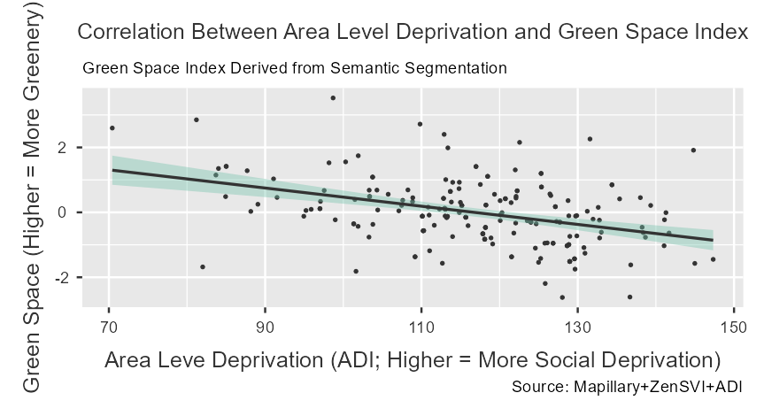
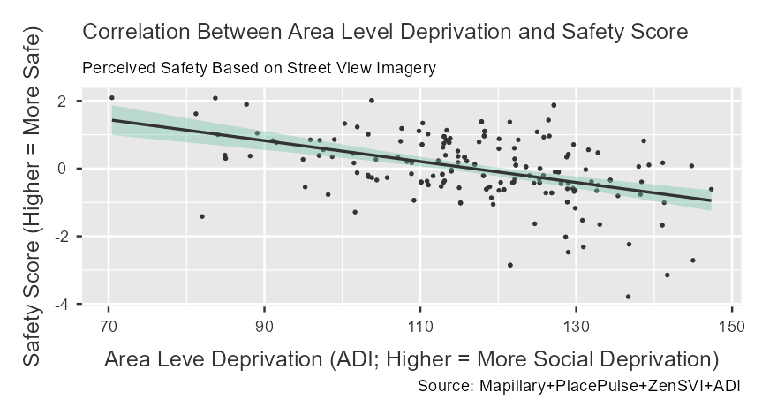
Higher Social Deprivation = Lower Green Space and Safety Perceptions
Figure 1. Correlation between Area Level Deprivation and Green Space Index. This scatterplot shows a negative association between the Area Deprivation Index (ADI; higher values indicate more social deprivation) and the Green Space Index (higher values indicate greater greenery at eye level).
Figure 2. Correlation between Area Level Deprivation and Safety Perception Score. This scatterplot depicts the relationship between the ADI and perceived safety scores derived from AI-based perception models.
Neighborhoods facing greater social disadvantage tend to have both fewer environmental assets and lower safety perceptions — two factors that can compound neglect risk

Slide 9
Descriptive Links Between Environment, Perception, Social Deprivation, and Child Neglect Risk
Note: Higher score = greater values of the indicator
Variable | Definition / Measures | Δ | Effect Size
Green Space Index | Mean neighborhood score of vegetation cover, visible sky, and terrain, etc. | 0.436 | 0.442
Surveillance Index | Mean neighborhood score of building frontage, fences, and walls, etc. | -0.121 | -0.146
Land Use Mix Index | Mean neighborhood score of bicycles, buses, cars, motorcycles, pedestrians, riders, roads, sidewalks, trains, and trucks, etc. | 0.200 | 0.269
Lighting Index | Mean neighborhood score of streetlights, traffic lights, poles, etc. | 0.129 | 0.336
Safety Perception | Mean neighborhood perceived score for ‘safer’ | 0.249 | 0.255
Boring Score | Mean neighborhood perceived score for “boring” | 0.0439 | 0.0446
Area Level Deprivation (ADI) | Area Deprivation Index | -9.478 | -0.712
High-neglect areas tend to have less greenery, poorer built environment conditions, lower perceptions of safety, and much higher levels of social deprivation.

Slide 10
Policy Implications and Future Directions
Implications for child welfare systems
Isolate factors associated with high risk: Identifies objective (e.g., green space, infrastructure) and subjective (e.g., safety perception) measures strongly associated with neglect risk.
Target high-risk locations: Spatial analysis shows exactly where — from individual sites to entire neighborhoods — environmental exposure risk is highest.
Evaluate for statutory alignment: Links California’s legal criteria for neglect to measurable neighborhood conditions, guiding place-based prevention and intervention.
Other ISSUES lab applications using machine learning
Structural Topic Models: Analyze narrative or text data (e.g., fatality reports, death records, police incidents) to detect spatial and thematic patterns.
Spatial Random Forest: Predict and map risk using environmental, social, and spatial features to detect the most important correlates of violence-related harm exposure.
Application of predictive analytics: Evaluate the conditions in which child welfare systems can use predictive analytics to prevent child harm (and when they cannot).

Slide 11
File Name | Measure | Unit of Analysis
pixel_ratios_wide.csv | Pixel-level proportion of each semantic segmentation class in a single image. pivoted to wide format — one row per image with each label as its own column. | Image-level
pixel_ratios_with_coords.csv | Pixel ratio data joined with lat/lon from mly_pids_renamed.csv. | Image-level with coordinates
mly_pids_renamed.csv | Mapillary photo IDs and coordinates for downloaded images with consistent column names for merging with segmentation output. | Image-level
combined_summaries_<indicator>_results.csv | Combined perception classification scores (e.g., “more depressing”) for all batches. | Image-level
summaries_<indicator>_map.geojson | Geospatial file mapping perception scores to coordinates. | Image-level with coordinates
image_metadata.csv | Image-level metadata from Mapillary (speed, heading, capture time, sequence). | Image-level
street_metadata.csv | Aggregated metadata per Mapillary sequence (street segment). | Street-segment level
grid_metadata.csv | Aggregated metadata by H3 hexagon grid. | Grid level
The code used to run this analysis is available on my lab’s GitHub website (in progress):
issues-osu/ai-neglect

